Slide 1
Rancho Santa Fe Fire
Operations & Training Board Report for September 2026
October 21, 2026
Pride – Professionalism – Excellence

Slide 2
SEPTEMBER Operations Report
Notable operational activity
2026

Slide 3
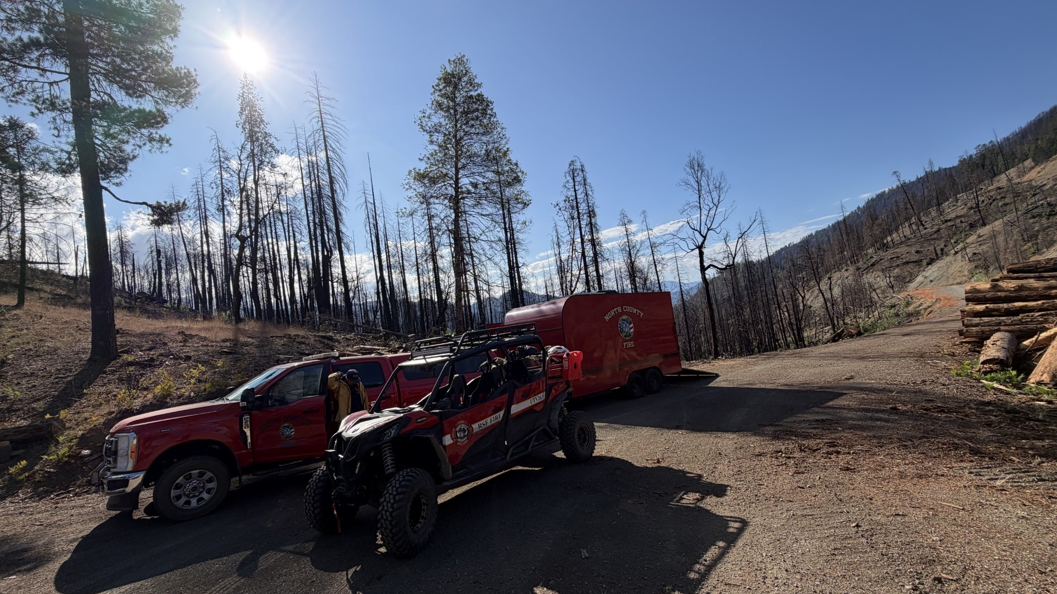

REMS, Hoopa, CA
MP18 Fire • Humboldt County

Slide 4
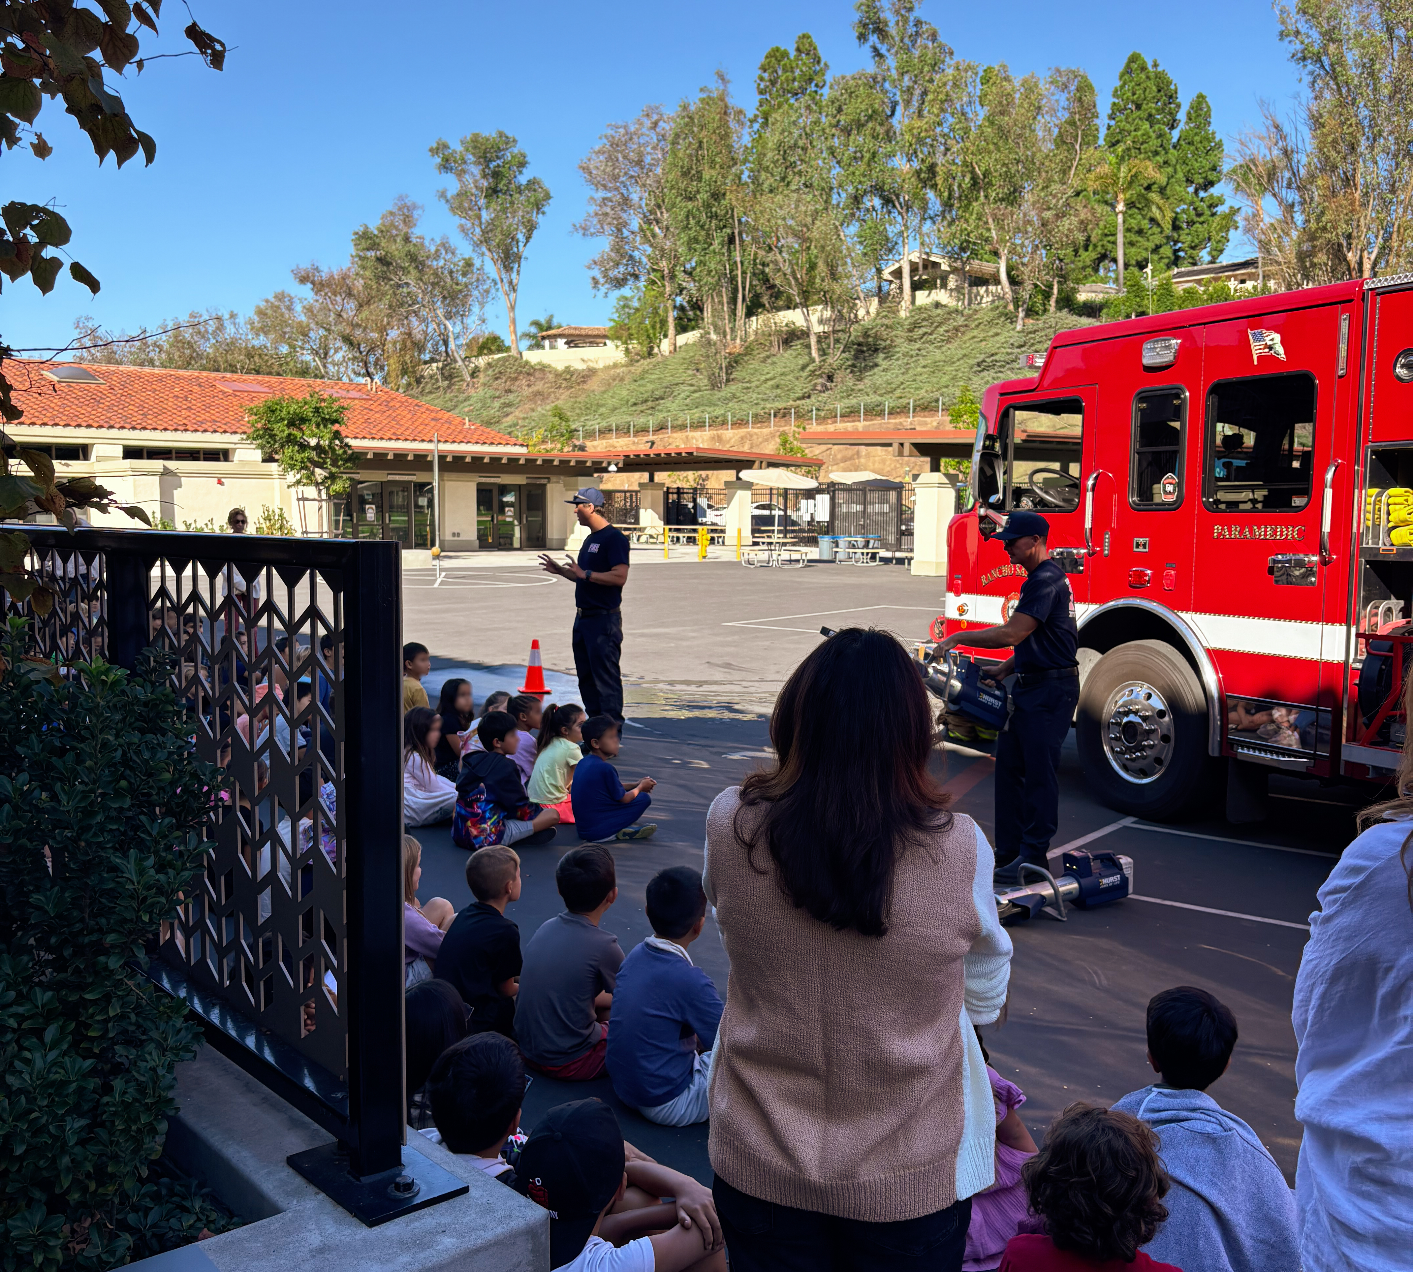
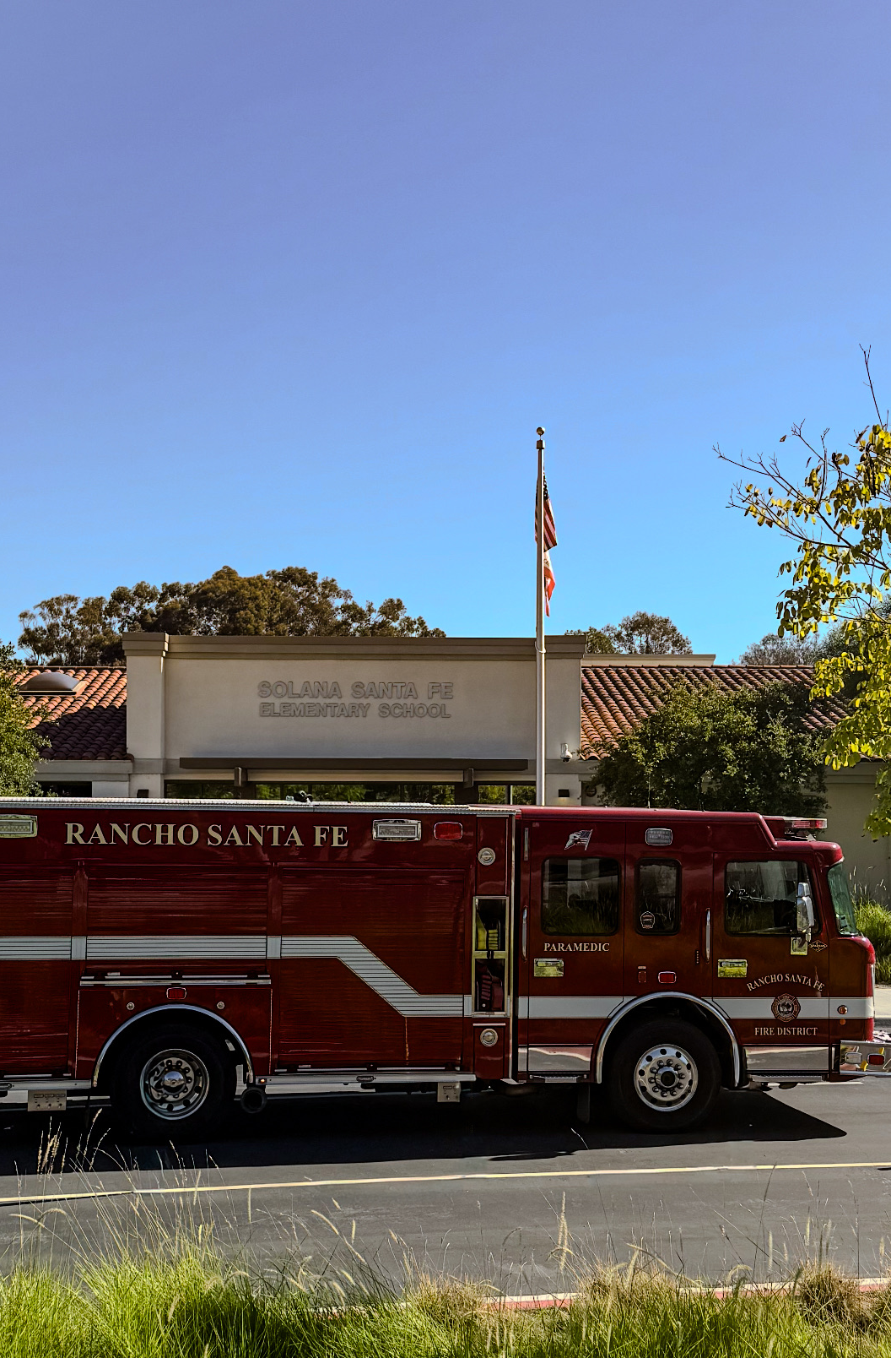
School Safety Tour
Solana Santa Fe Elementary School

Slide 5
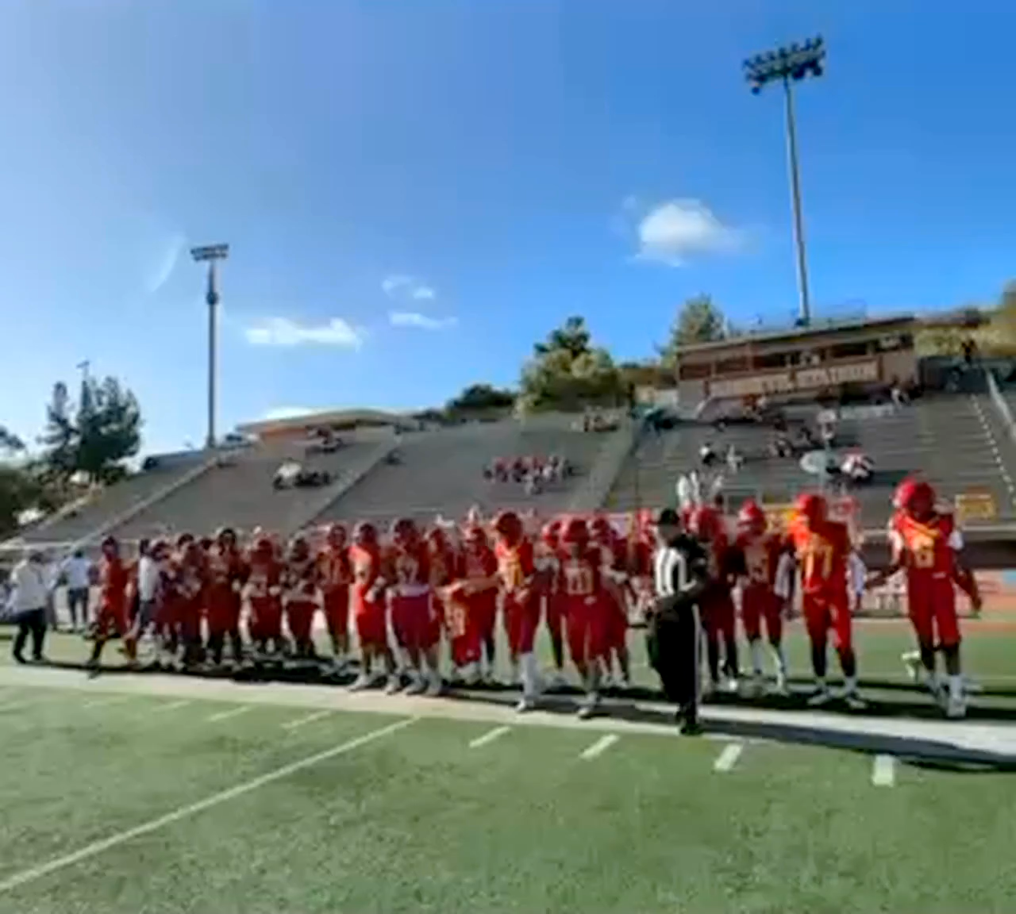
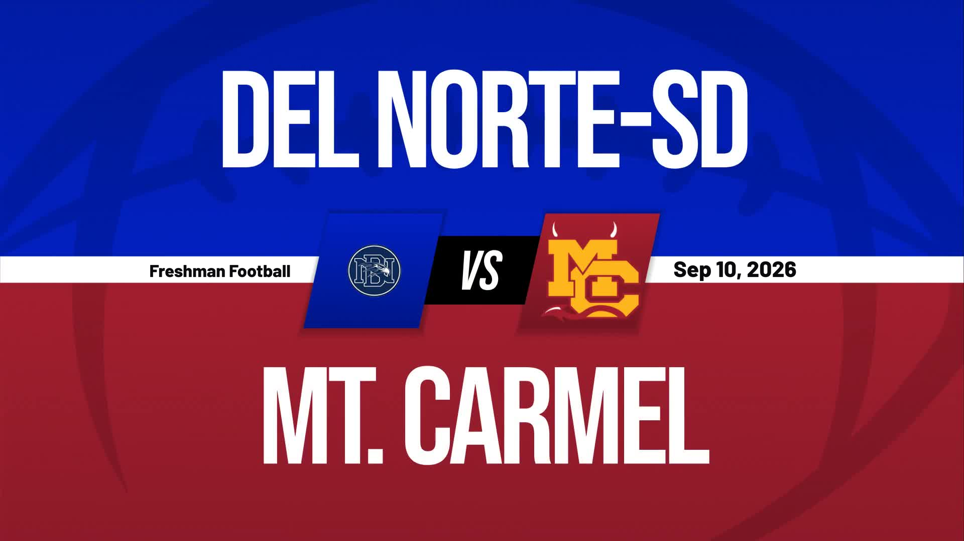

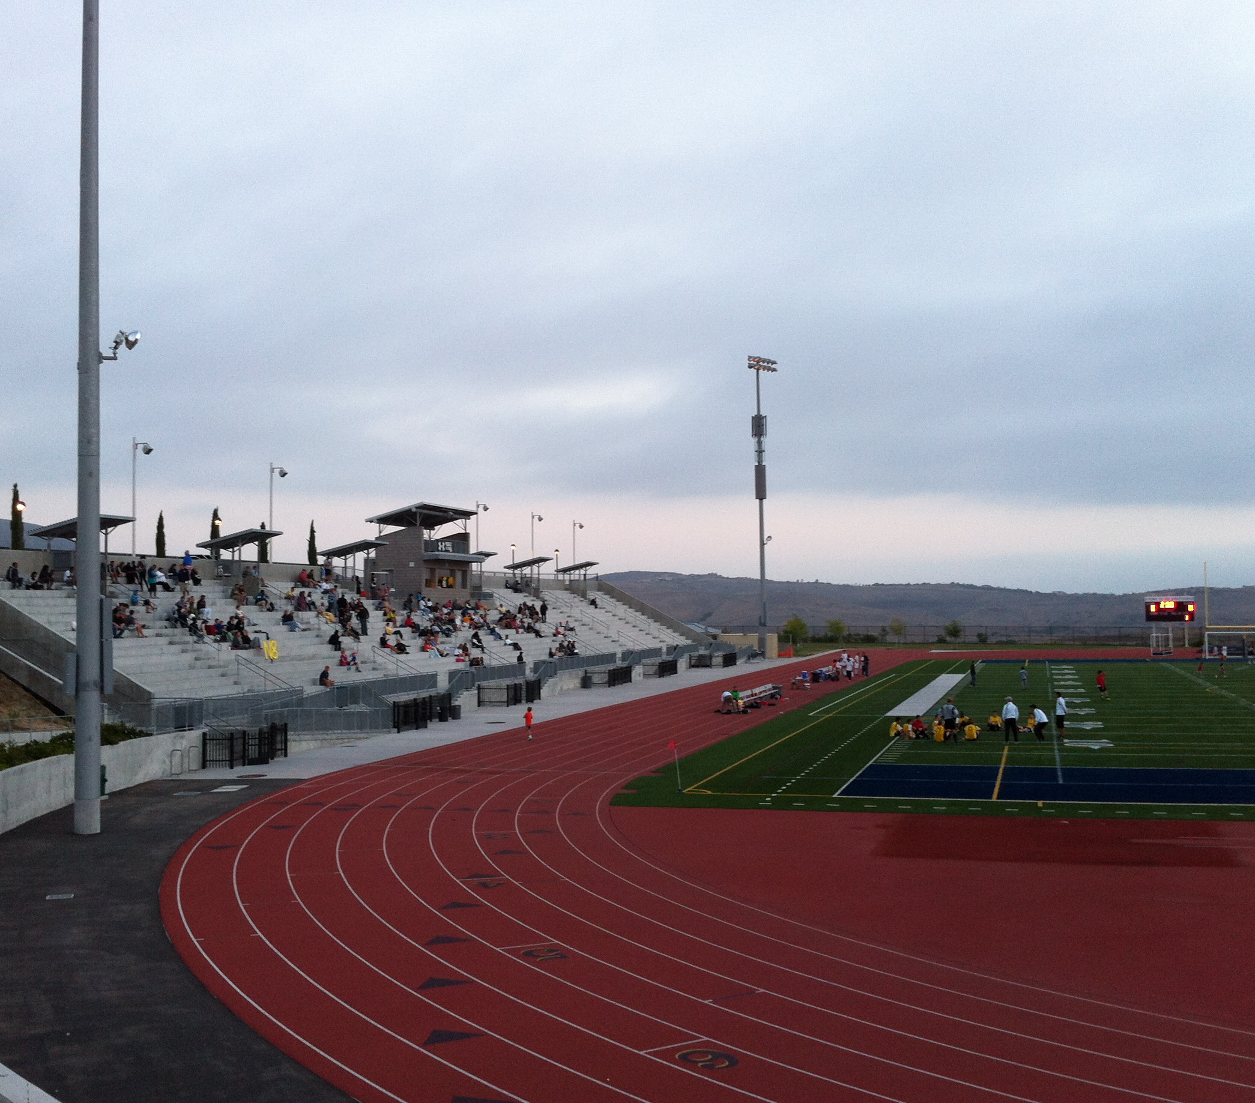
CPR Save
Del Norte High School

Slide 6
SEPTEMBER Training Report
Notable Training Activity
2026

Slide 7



Notable Training Activity
Zone Drill
  Rope Rescue
Training Committee Drill
  Technical Rescue
CERT Training
  Stop the Bleed
PPE Training
  Prevention
EMS Training
  ZOLL Monitor Trial
Training Plan

Slide 8
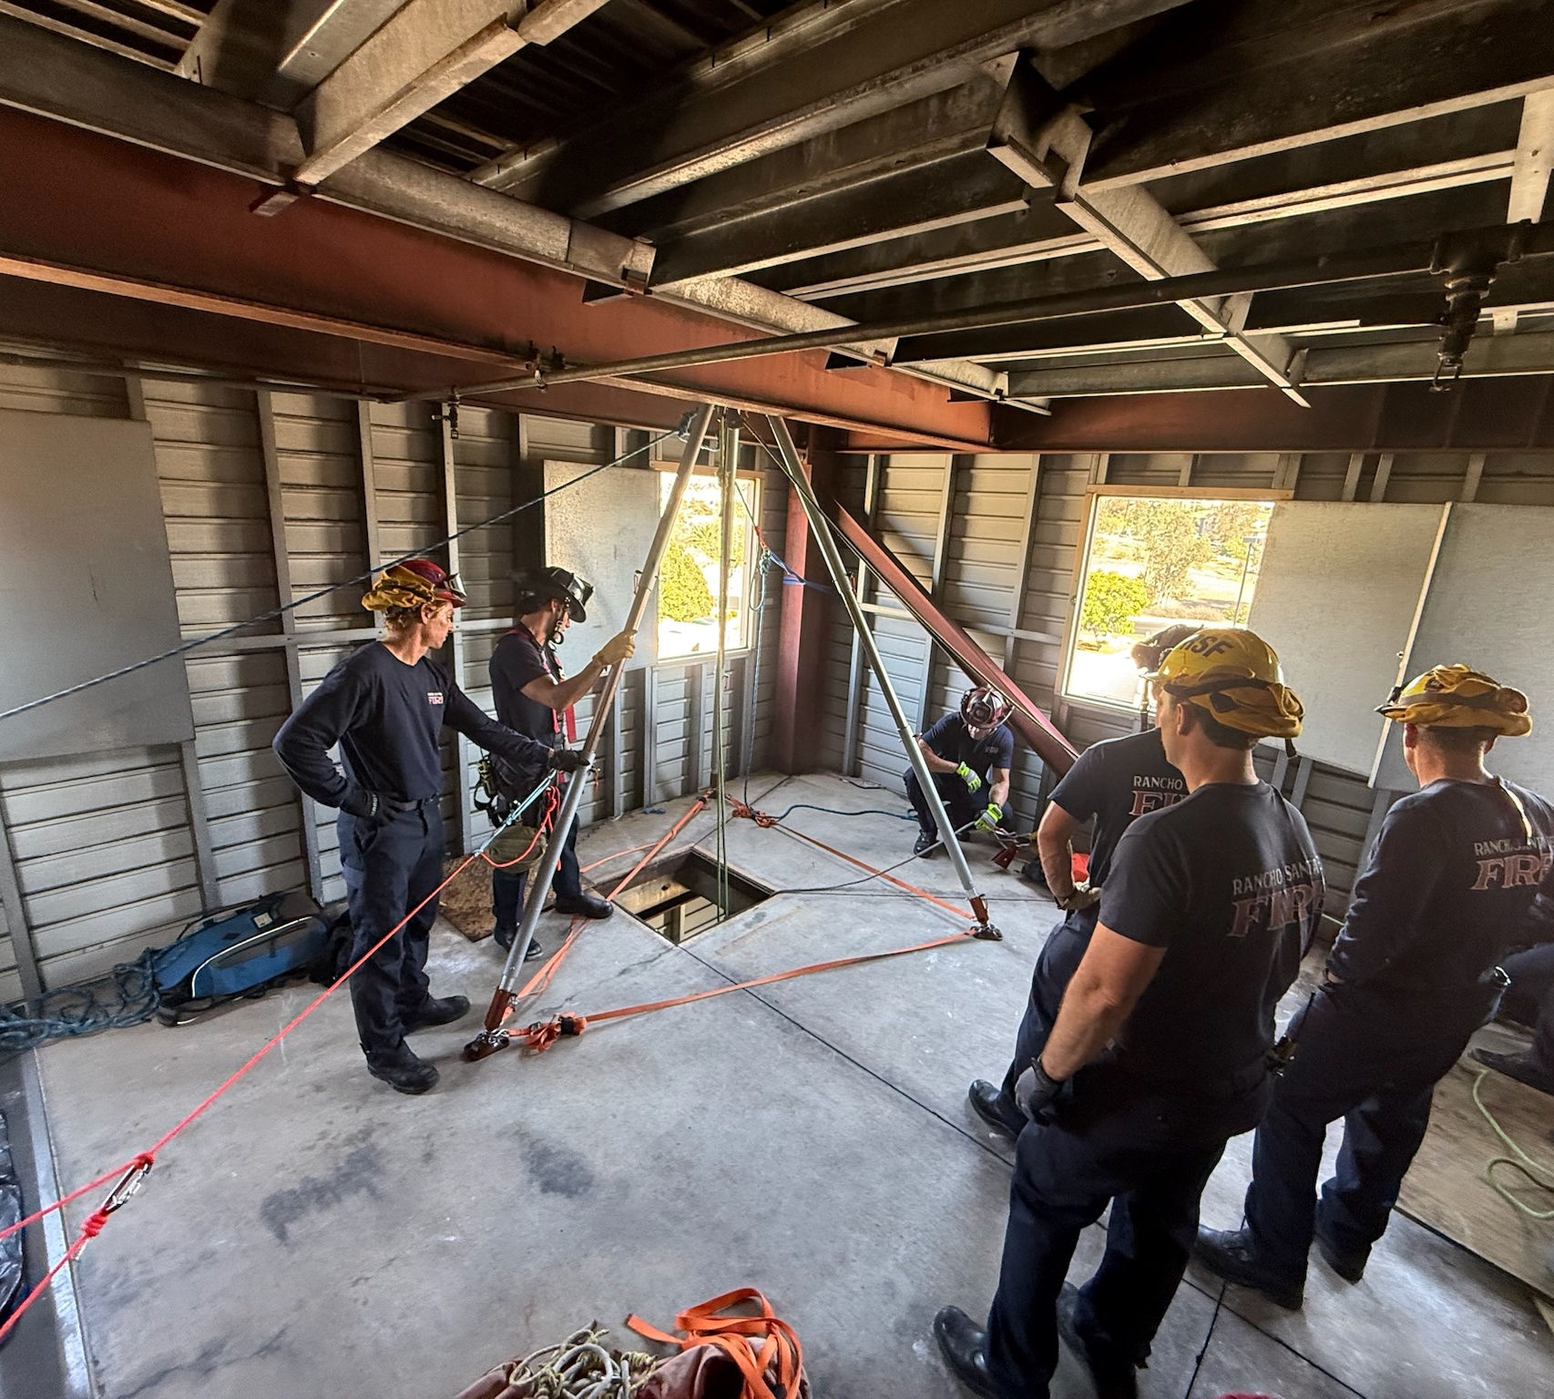
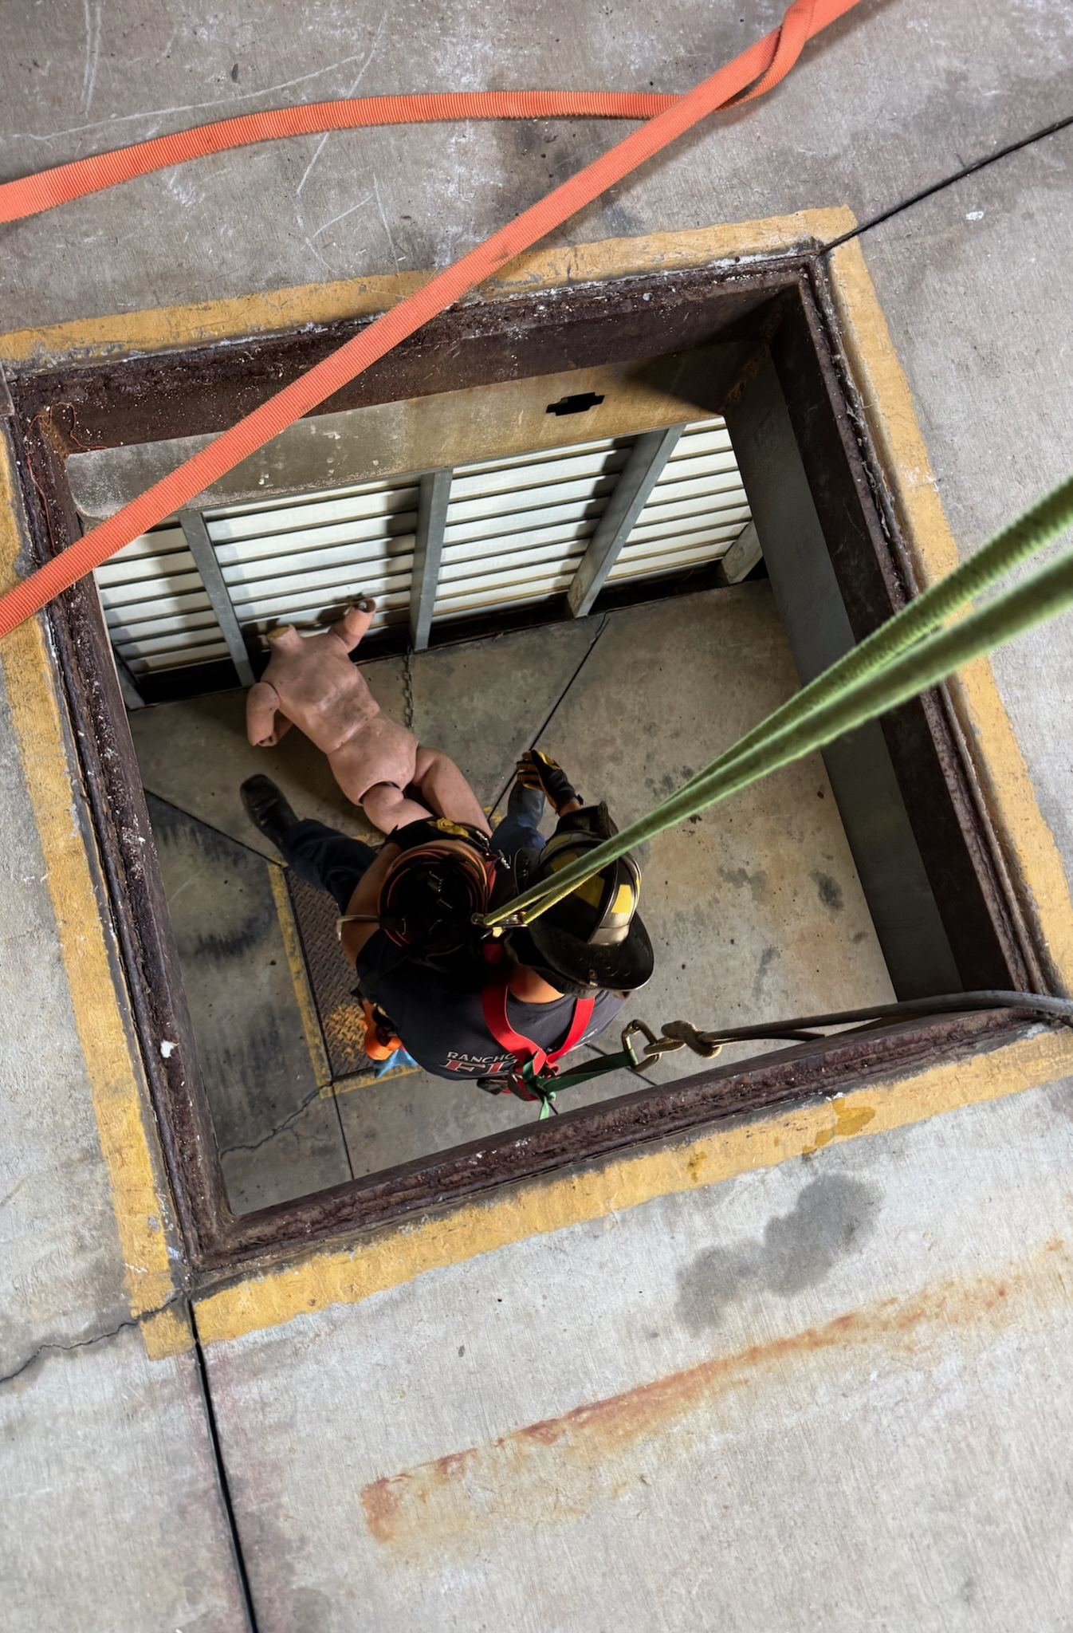
Technical Rescue Drill
Rancho Santa Fe Fire Training Committee

Slide 9
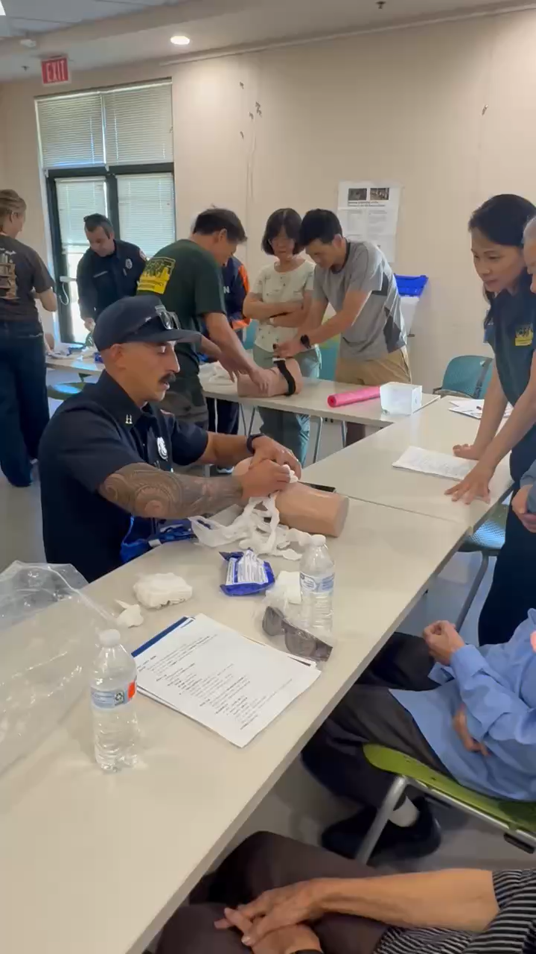
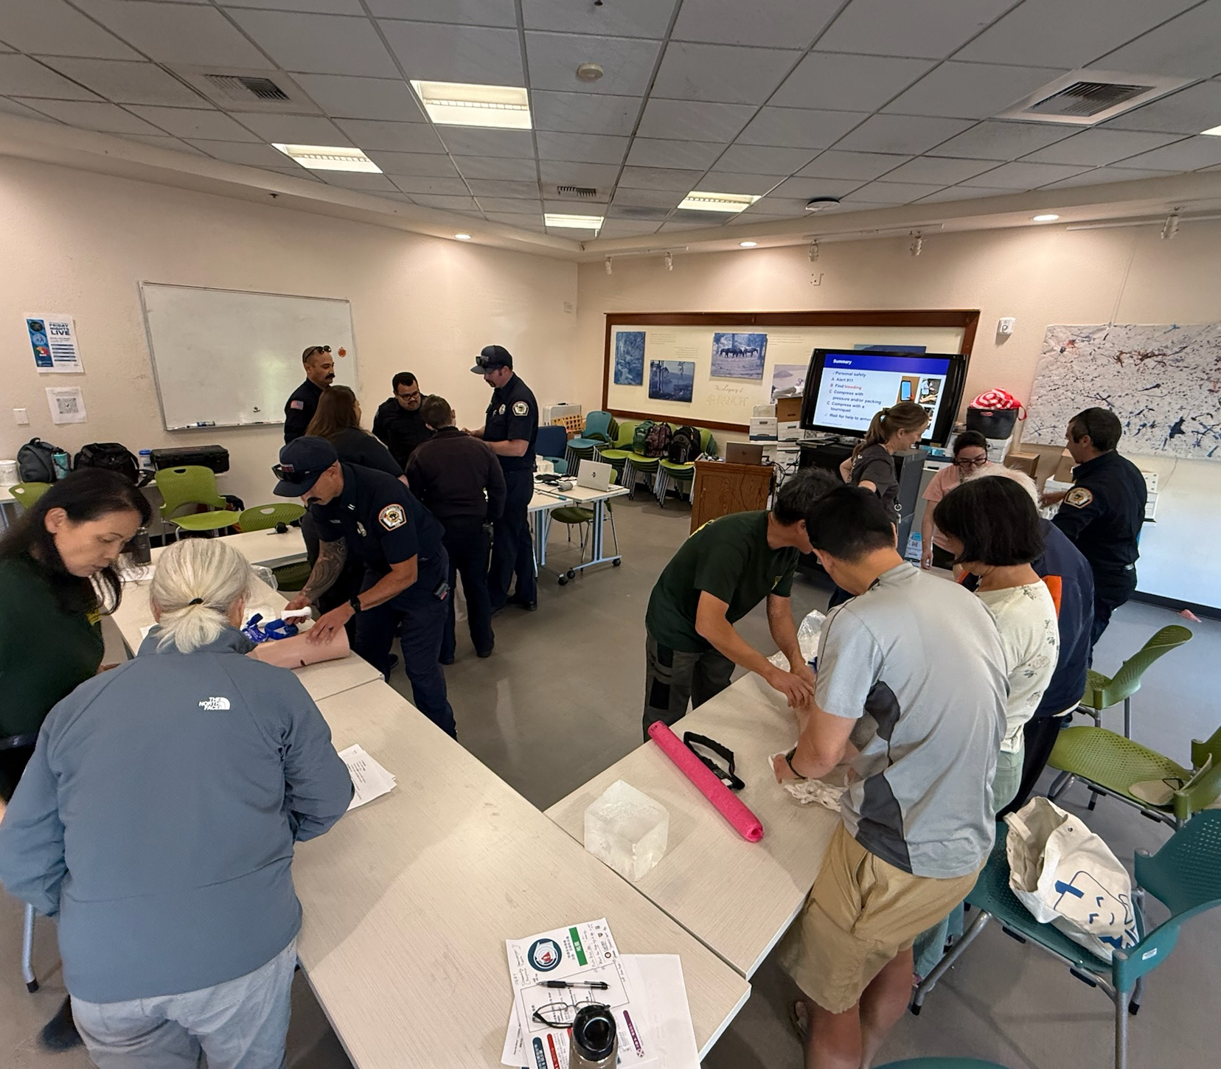
CERT Training
Earthquake Awareness & Preparedness

Slide 10
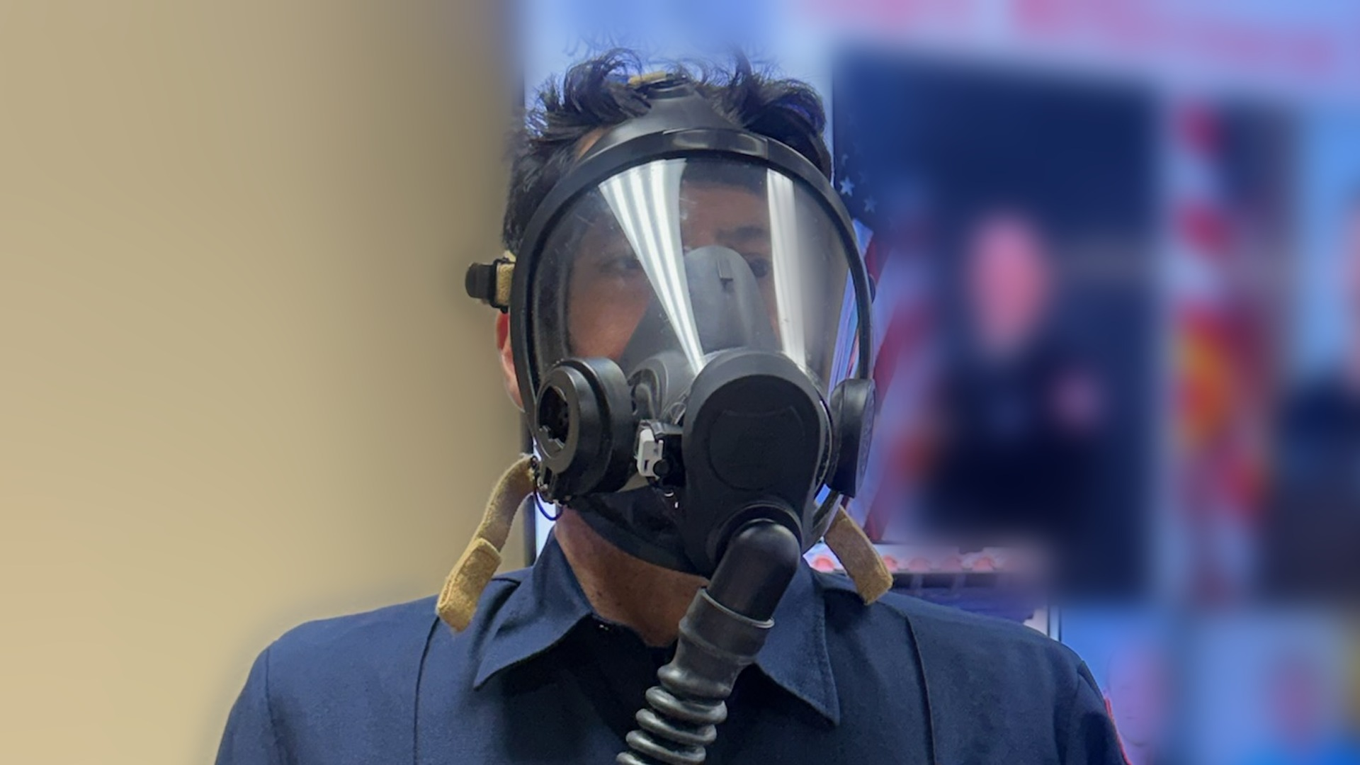
Prevention PPE Training
Respiratory Protection

Slide 11
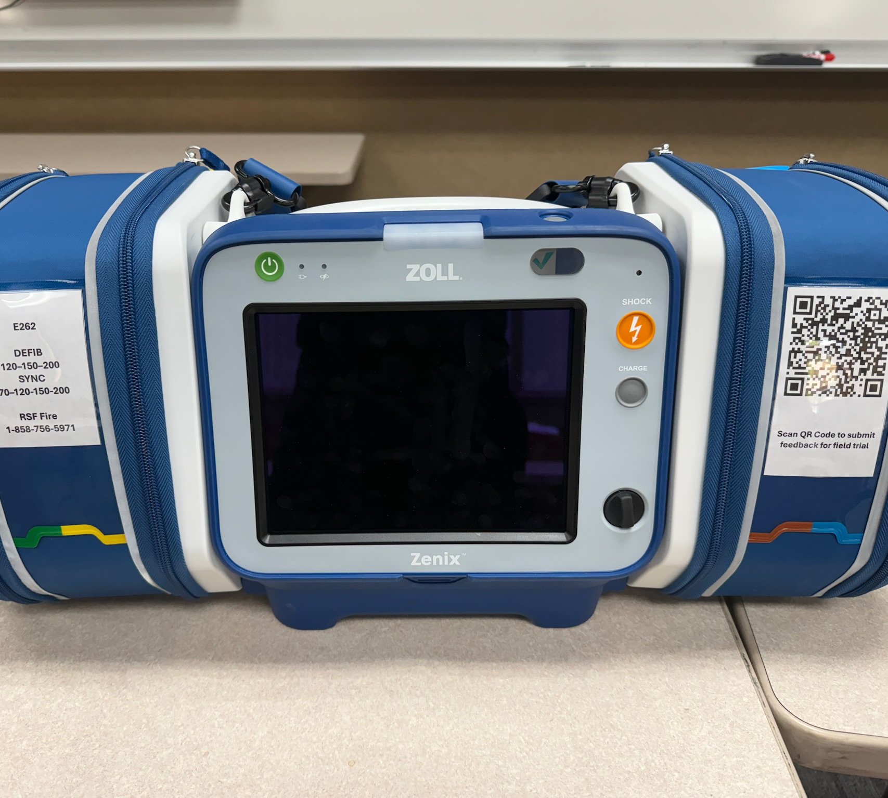
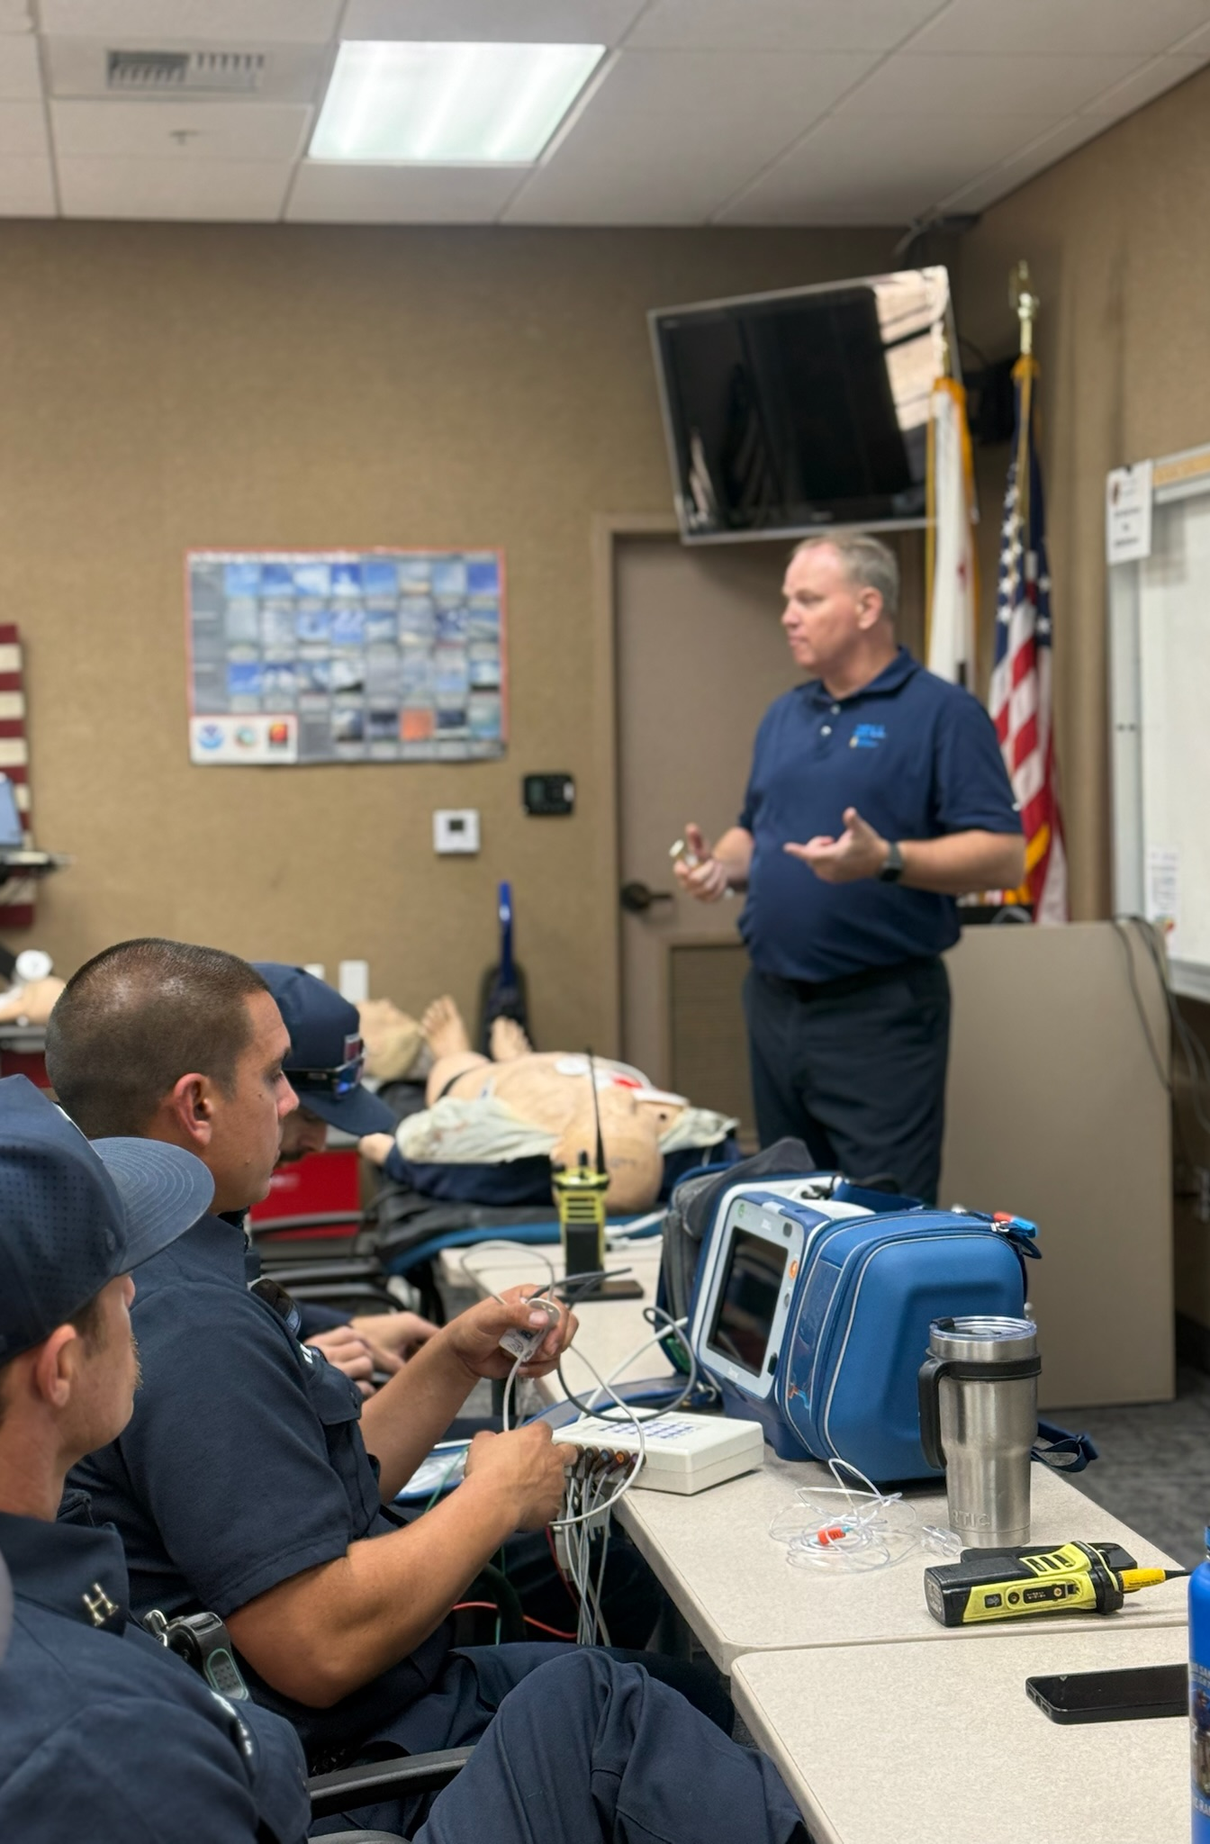
EMS Training
Zoll Monitor Trial

Slide 12
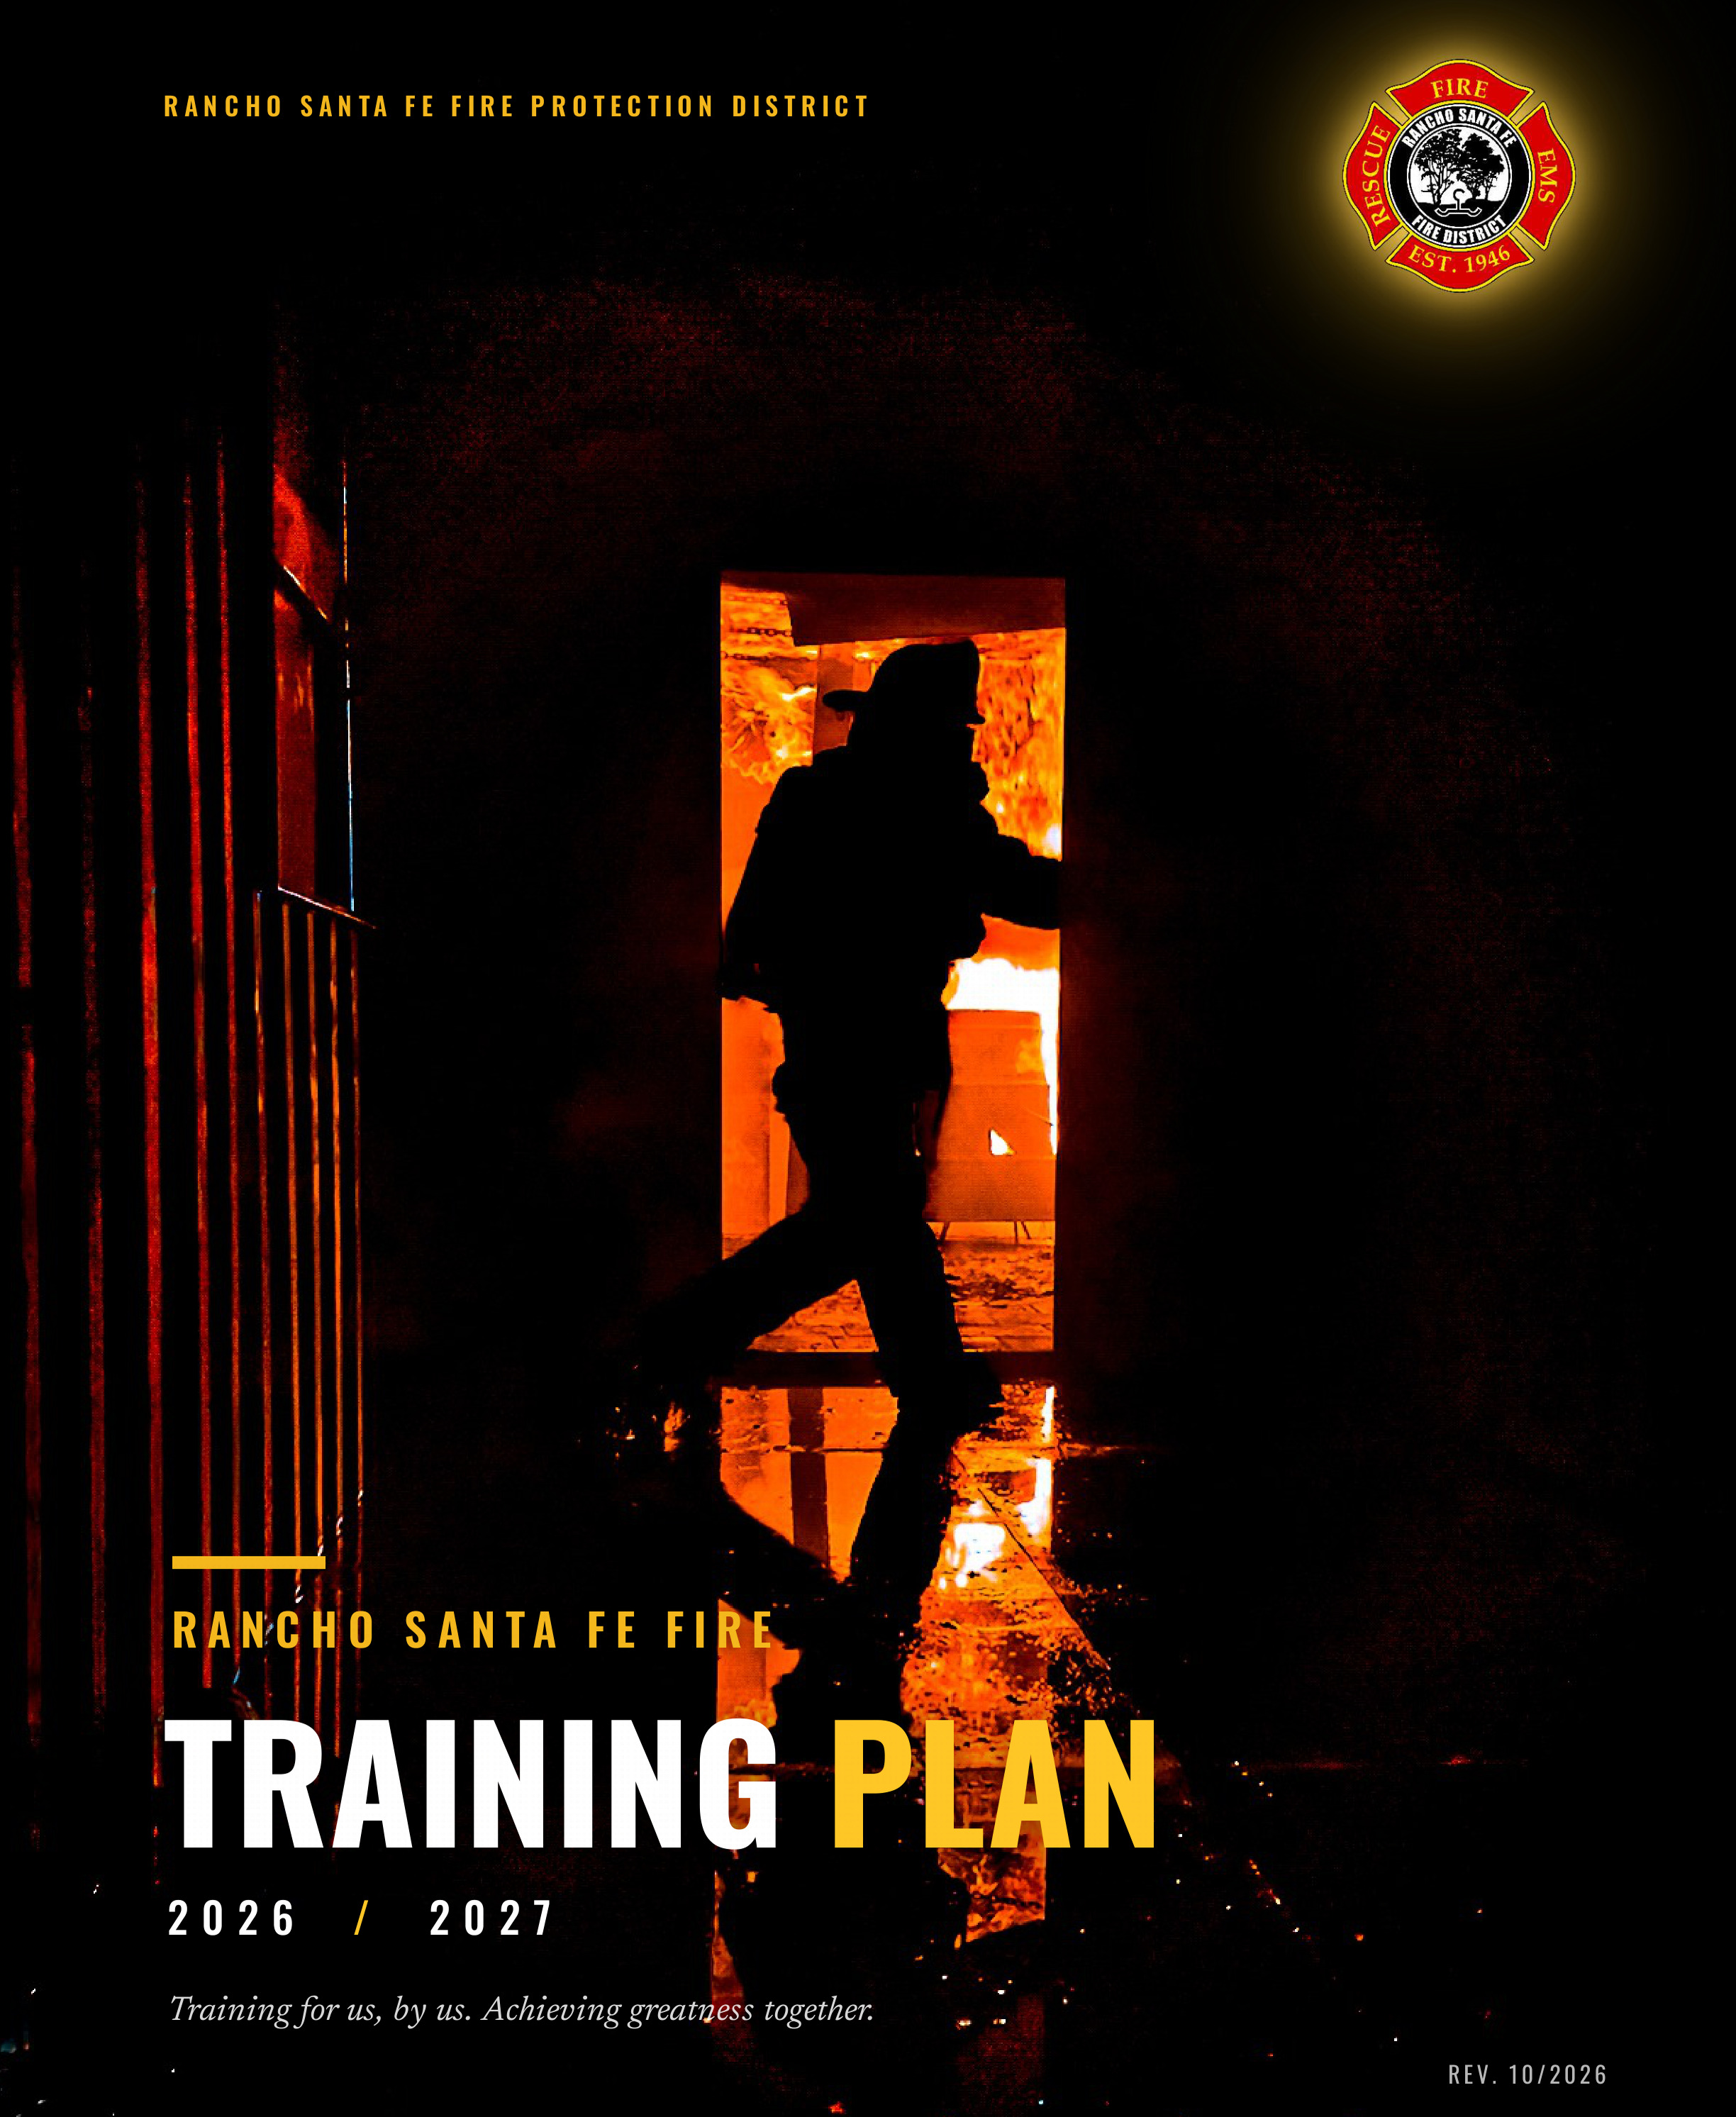
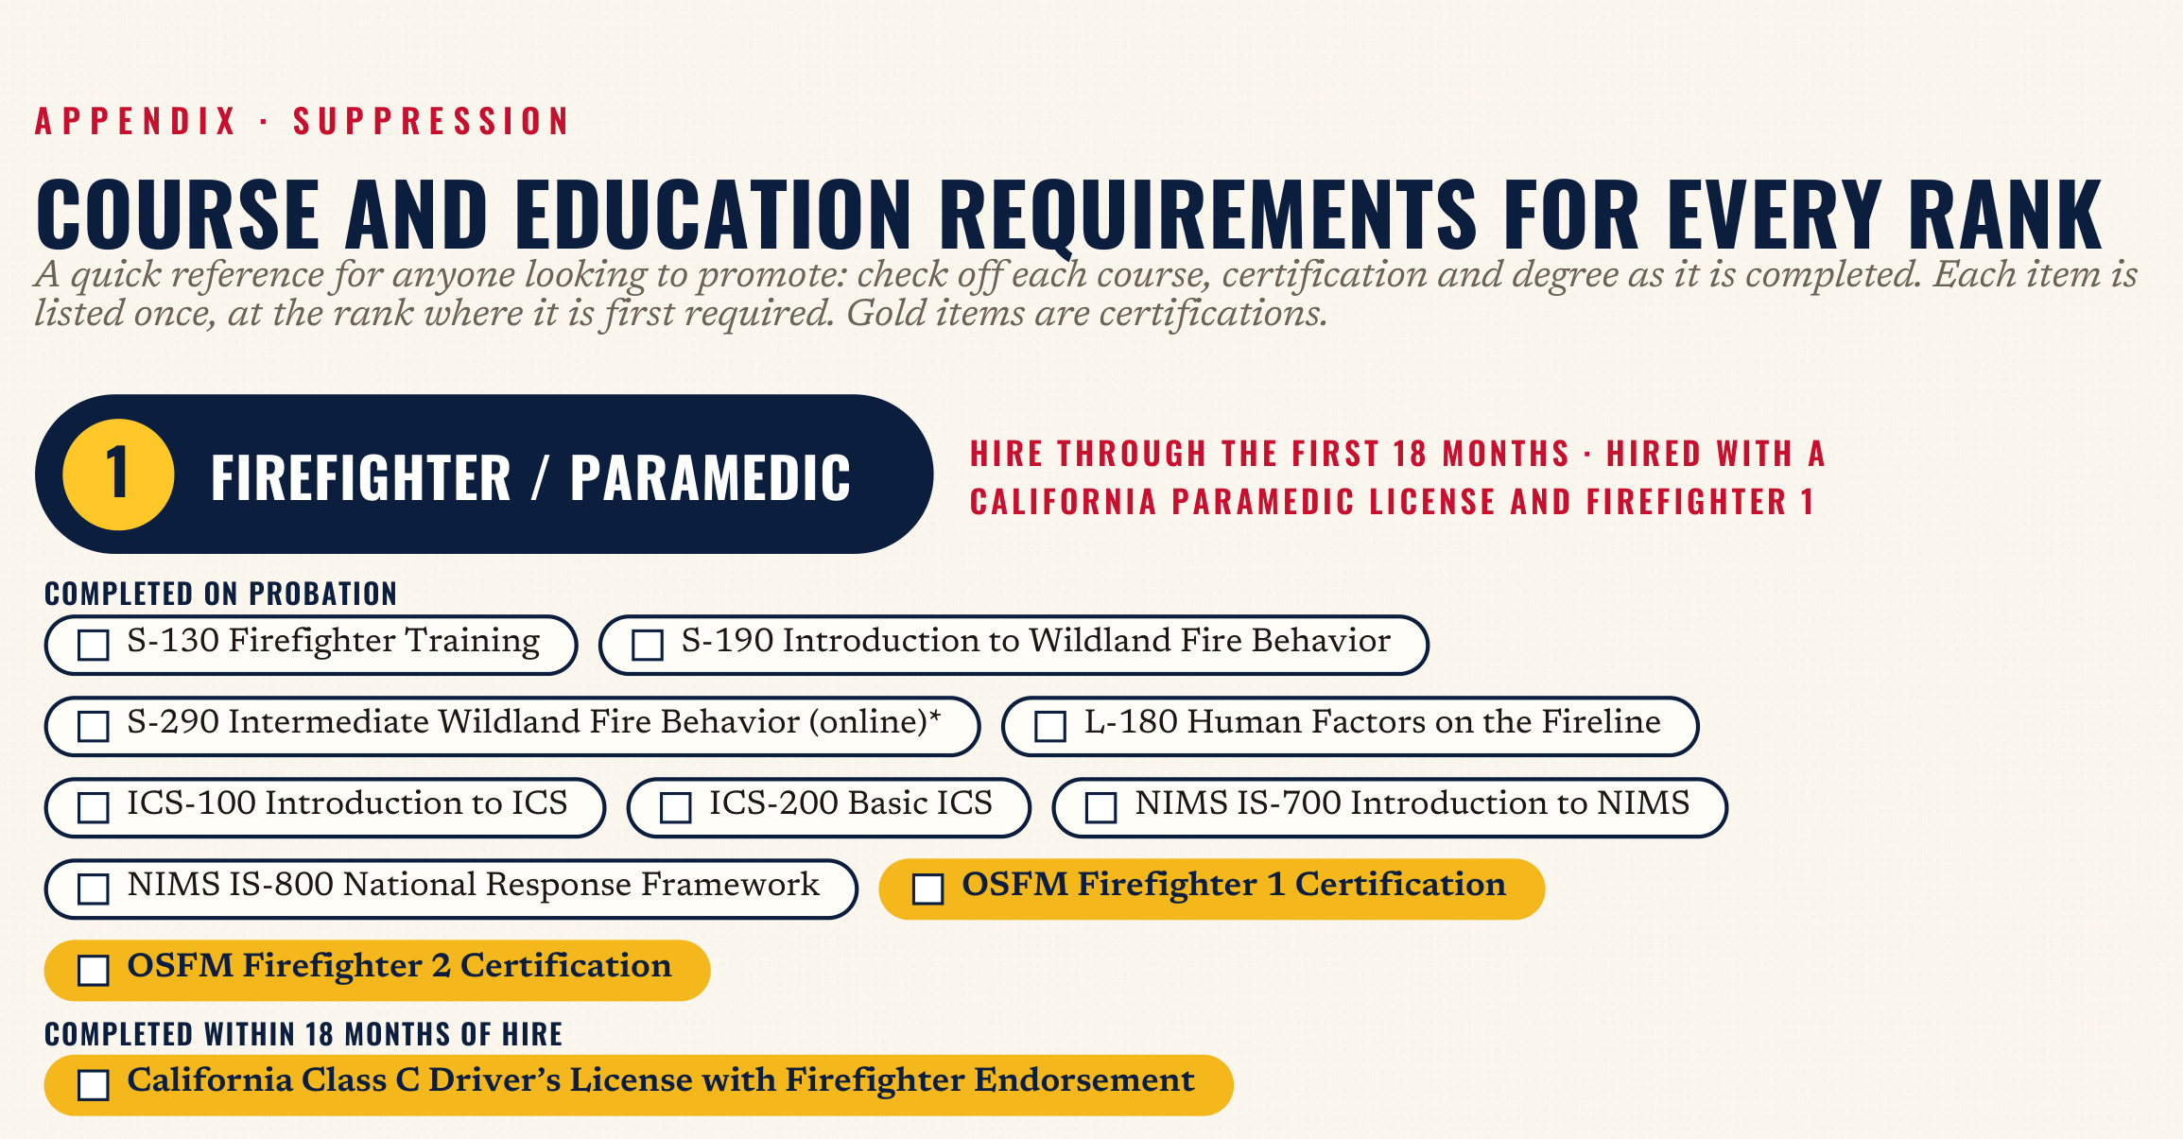
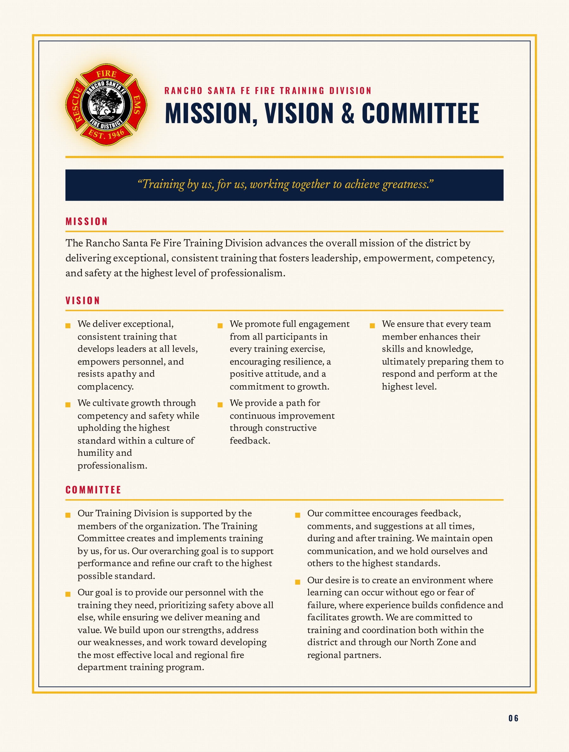
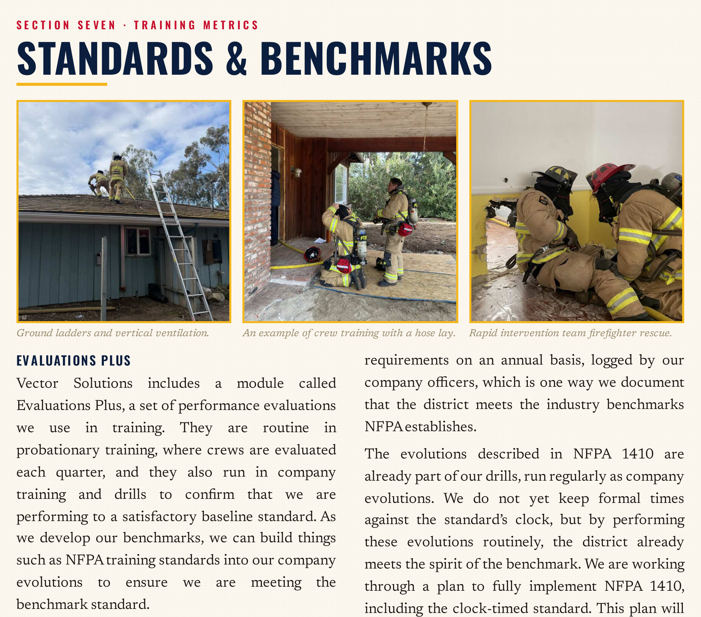
Rancho Santa Fe Fire Training Division

Slide 13
End of Report
Operations & Training Board Report for October 2026
October 21, 2026
Pride – Professionalism – Excellence

Slide 14
Feature Slide Template
These hidden slides are your template and do not show in a slideshow.
To make a slide: right-click a sample, Duplicate Slide, drag the copy into place, then right-click it and choose Hide Slide to turn the hiding off.
Photo samples (first three): click a tile icon and pick photos. They crop to fill the tile automatically.
Any-media samples (last three): use these when a tile needs a video. Pictures here are not auto-cropped, so select the picture and use Picture Format > Crop > Fill.
If anything lands out of its frame, click Home > Reset and it snaps back. Do not drag media by hand.
If the title or gradient disappears behind a photo, right-click the photo and choose Send to Back.
Then edit the title and gold subtitle.

Slide 16
Title goes here
Photos: 4 tiles, auto-fill

Slide 17
Title goes here
Photos: 2 tiles, auto-fill

Slide 18
Title goes here
Photos: 1 tile, auto-fill

Slide 19
Title goes here
Any media: 4 tiles

Slide 20
Title goes here
Any media: 2 tiles

